Slide 1

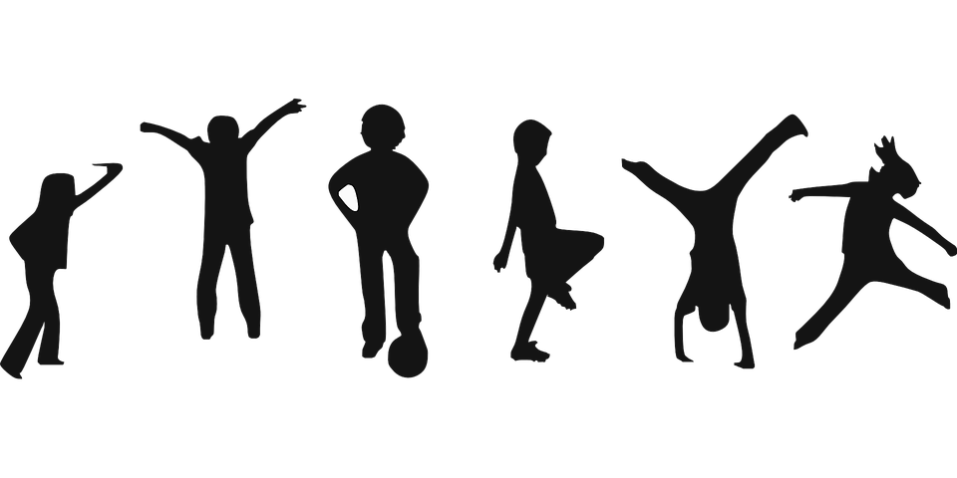
Let’s get active!

Slide 2

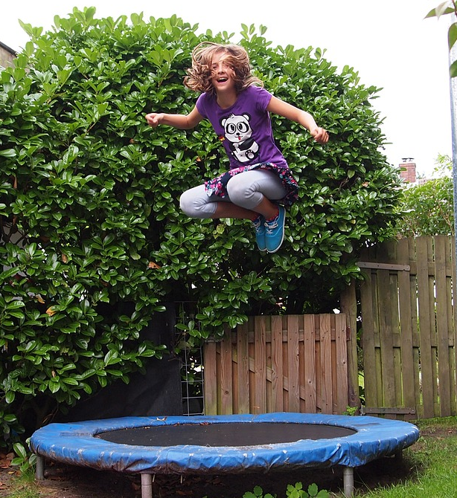
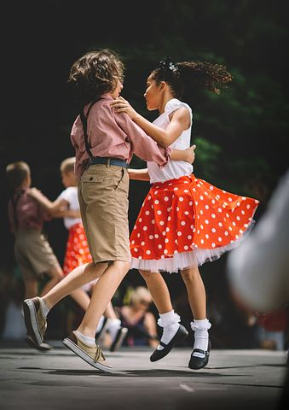
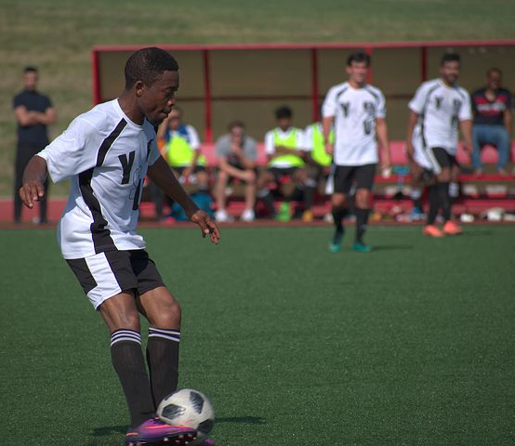
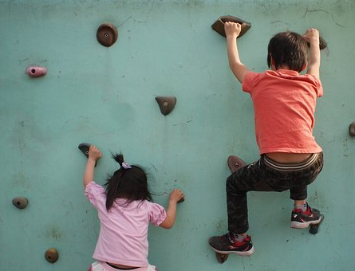
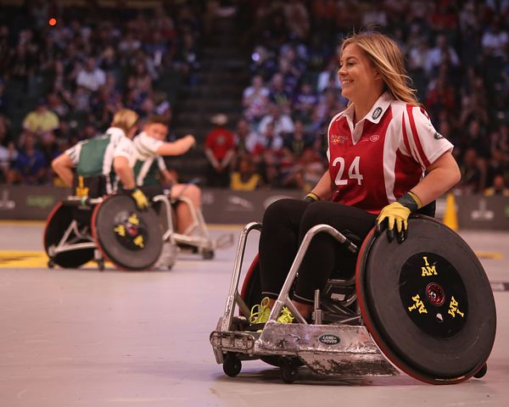
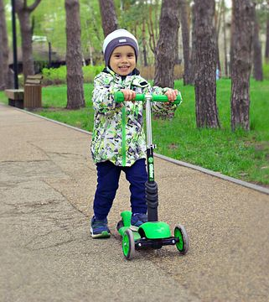
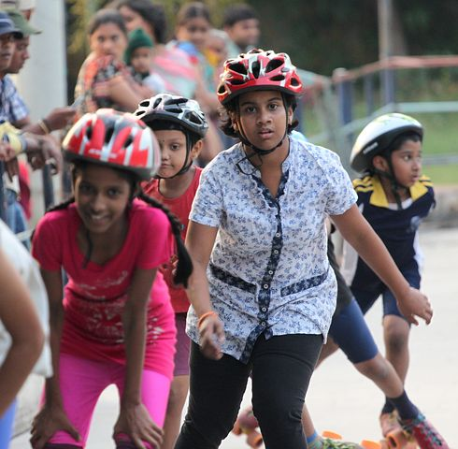
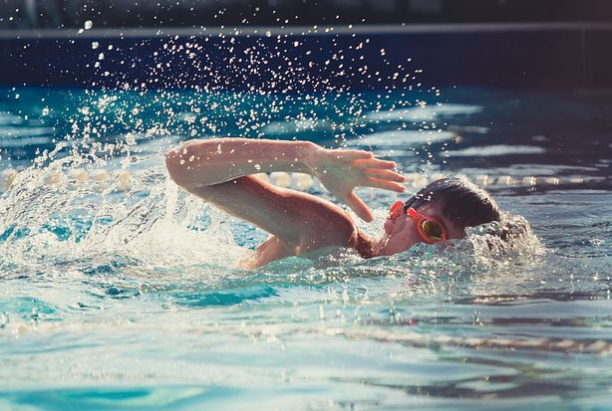
Q. What is happening in all of the pictures?
2
© Young Citizens

Slide 3
Everyone is being ACTIVE!
3
© Young Citizens

Slide 4
Q. How are the children using their bodies?
4
© Young Citizens

Slide 5
Q. Which activity would you most like to try?
5
© Young Citizens

Slide 6
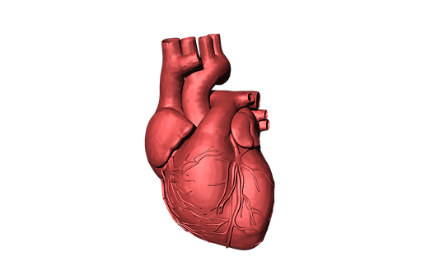
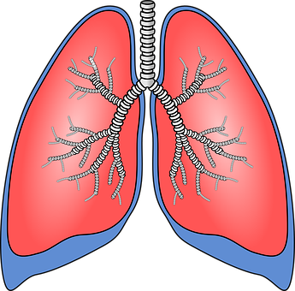
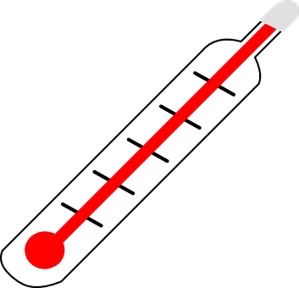
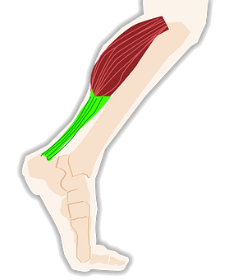
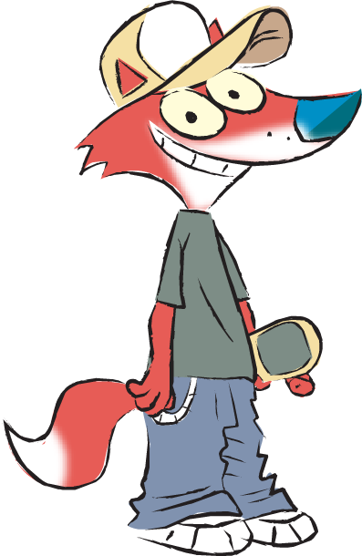
 |  | Evidence of activity
Activity | How do you feel? ☺ | Is your heart beating faster? | Are you breathing faster? | Do you feel warmer? | Which muscles are you working?
Tag
Standing long jump
Hula hooping
Hit the target
Hopping
Bench step
Animal races
Let’s get active!
6
© Young Citizens
Notes:
References:
https://www.nhs.uk/live-well/exercise/physical-activity-guidelines-children-and-young-people/

Slide 7
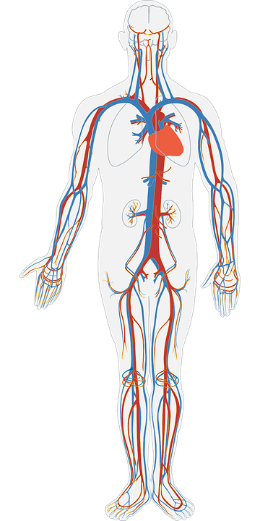

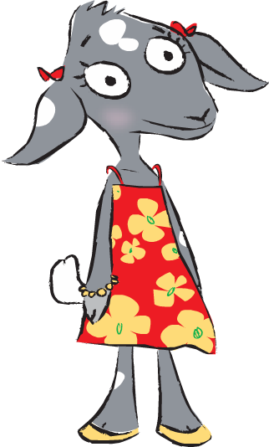
As you exercise, the heart does the important job of pumping blood around your body.
Feel for your heart or pulse points and silently count the beats as your teacher times 30 seconds.
Blood carries oxygen.
Every part of our body needs oxygen to work.
7
© Young Citizens
Notes:
References:
https://www.nhs.uk/live-well/exercise/physical-activity-guidelines-children-and-young-people/

Slide 8
Which activity do you think was best for learning to control your body?
 |  | Evidence of activity
Activity | How do you feel? ☺ | Is your heart beating faster? | Are you breathing faster? | Do you feel warmer? | Which muscles are you working?
Tag
Standing long jump
Hula hooping
Hit the target
Hopping
Bench step
Animal races
Which activity do you think was best for strengthening your muscles?
Which activity do you think was best for improving your speed?
Which activity do you think was best for increasing your heart rate?
How did doing these activities makes you feel?
8
© Young Citizens
Notes:
References:
https://www.nhs.uk/live-well/exercise/physical-activity-guidelines-children-and-young-people/

Slide 9
Q. Why does it feel good to be active?
9
© Young Citizens

Slide 10
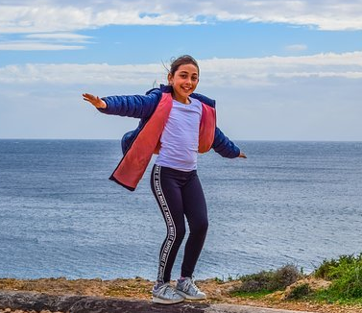
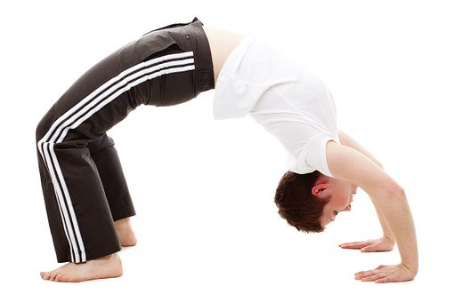
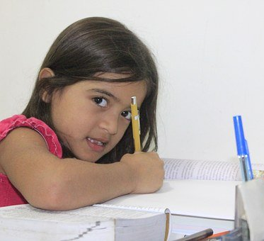
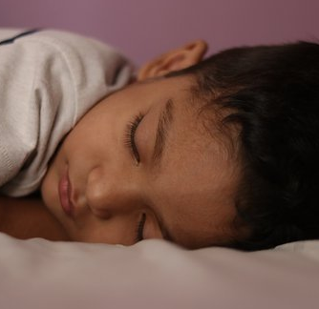
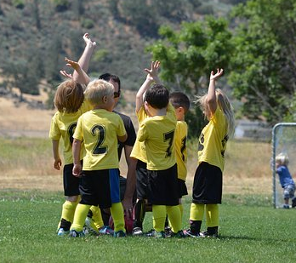
Activity builds strong bones and muscles.
Activity improves balance.
Activity improves flexibility.
Activity is fun and a great way to make friends.
After activity we can focus better on our learning.
Being active in the day helps us sleep well.
10
© Young Citizens
Notes:
References:
https://www.gosh.nhs.uk/medical-information/general-health-advice/leading-active-lifestyle/exercise-children-and-young-people

Slide 11


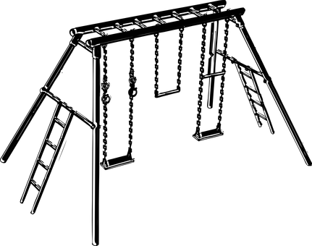
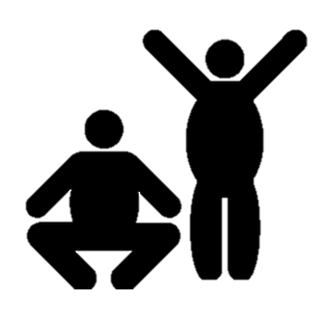
It feels good to be active each day. It keeps my body healthy and its lots of fun.
Day | My Activity
Monday | Walked to school
 | Played tag at playtime
 | Played on the climbing frame and swings lunchtime
 | Gymnastics in PE
11
© Young Citizens
Notes:
https://www.nhs.uk/live-well/exercise/physical-activity-guidelines-children-and-young-people/

Slide 12
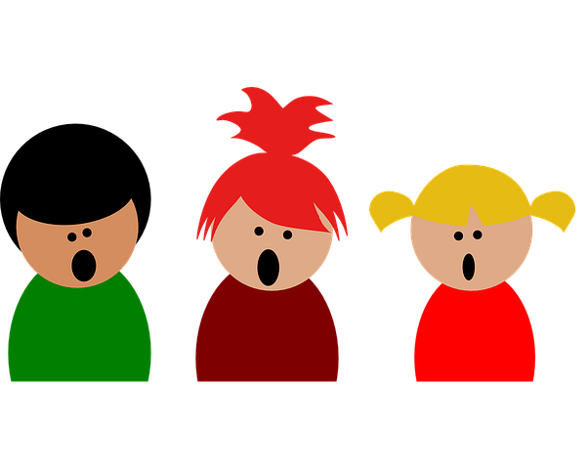
I know I’m keeping my body active if I can talk but I do not have enough breath to sing.
When I’m active…
I feel good
My heart beats faster
I breathe faster
I feel warmer
12
© Young Citizens
Notes:
References:
https://www.nhs.uk/live-well/exercise/physical-activity-guidelines-children-and-young-people/

Slide 13
Q. What activity do you ///do that…
Makes you feel good?
Makes your heart beat faster?
Makes you breathe faster?
Makes you feel warmer?
13
© Young Citizens
Notes:
References:
https://www.nhs.uk/live-well/exercise/physical-activity-guidelines-children-and-young-people/

Slide 14
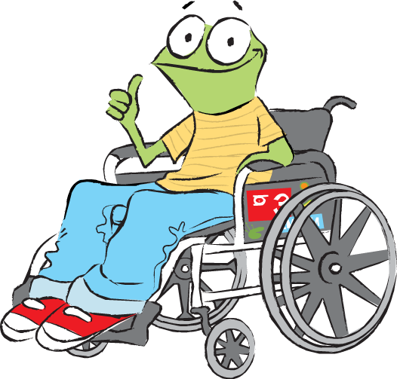
Plenary
Tell me 1 playground game that is good exercise
Tell me 2 places that you can feel your pulse.
Tell me 3 reasons why exercise is good for you.
14
© Young Citizens
Notes:
References:
https://www.nhs.uk/live-well/exercise/physical-activity-guidelines-children-and-young-people/

