Slide 1


People who are special to me

Slide 2

Special
2
© Young Citizens

Slide 3
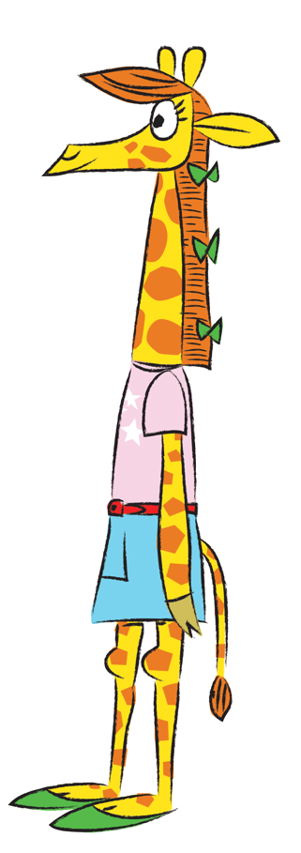
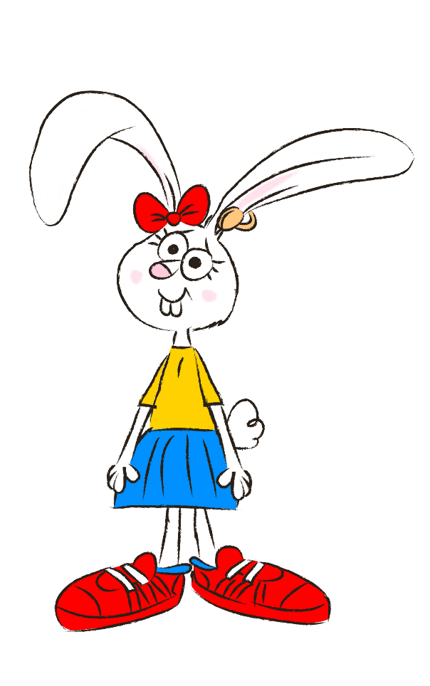
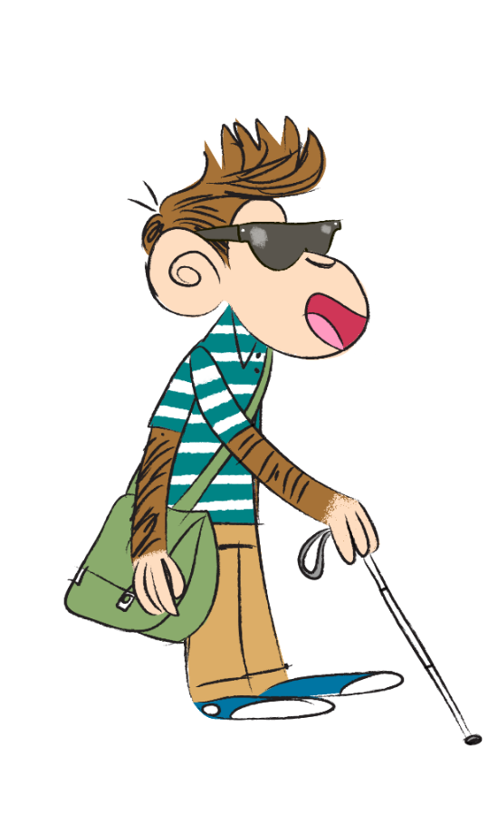
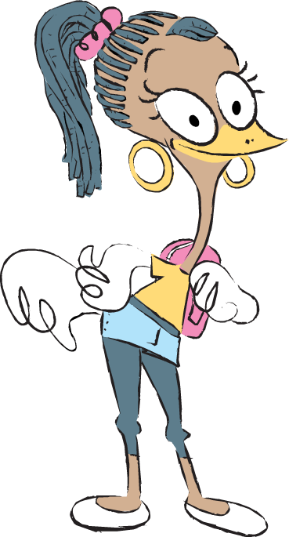
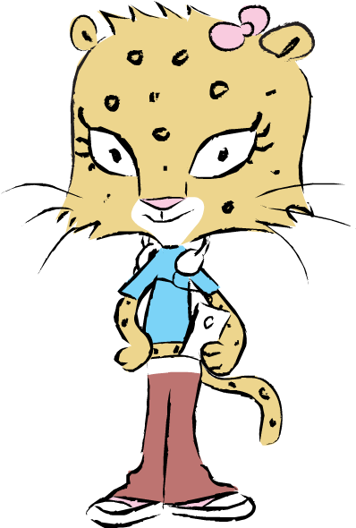
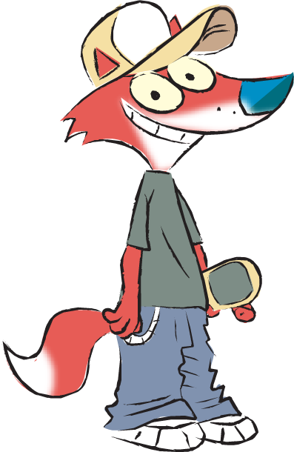
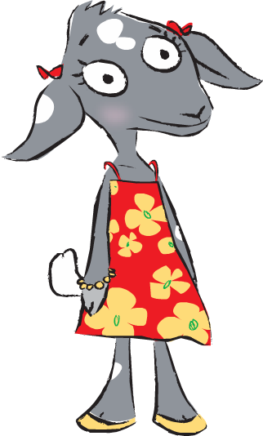
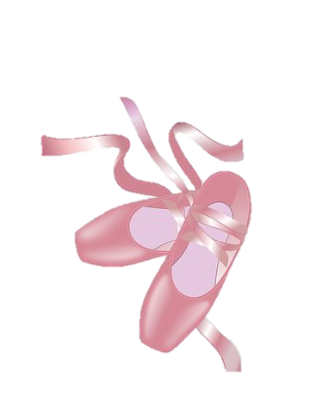
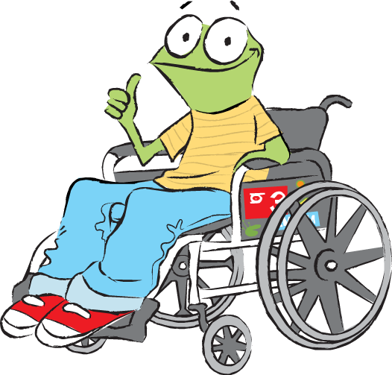
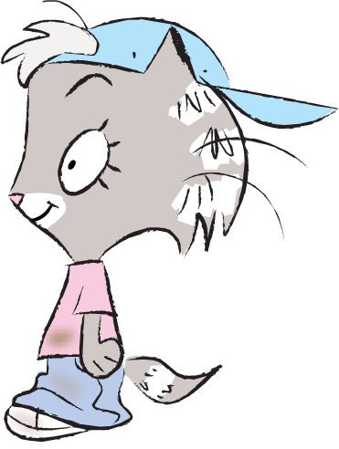
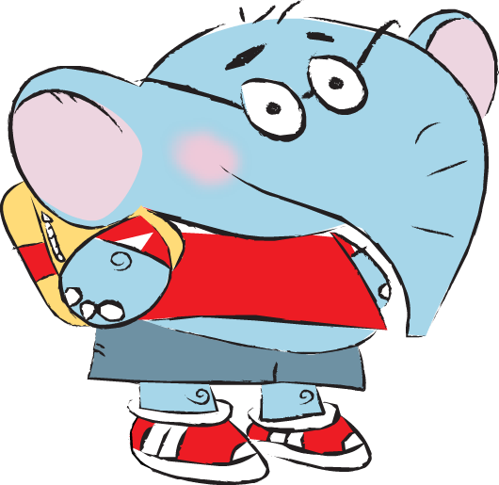
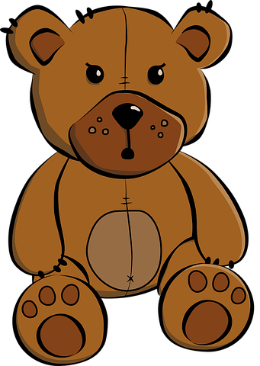
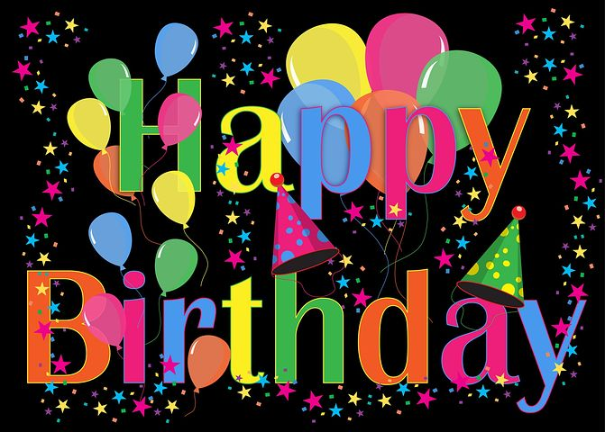
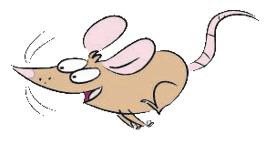
We all have things that are special to us.
My first teddy!
I still hug him when I can’t sleep.
The birthday cards I get in the post from my family who live far away.
The dance shoes I wore for the school show.
3
© Young Citizens

Slide 4
In this lesson we will be thinking about the most special things of all, special people.
4
© Young Citizens

Slide 5
Look at the pictures we drew to show the people who are special to us and why they are so special.
Why might a person be special to us?
5
© Young Citizens

Slide 6

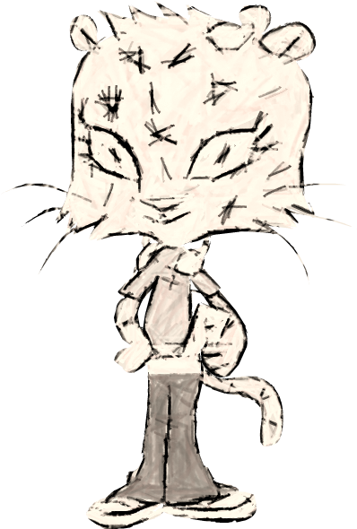
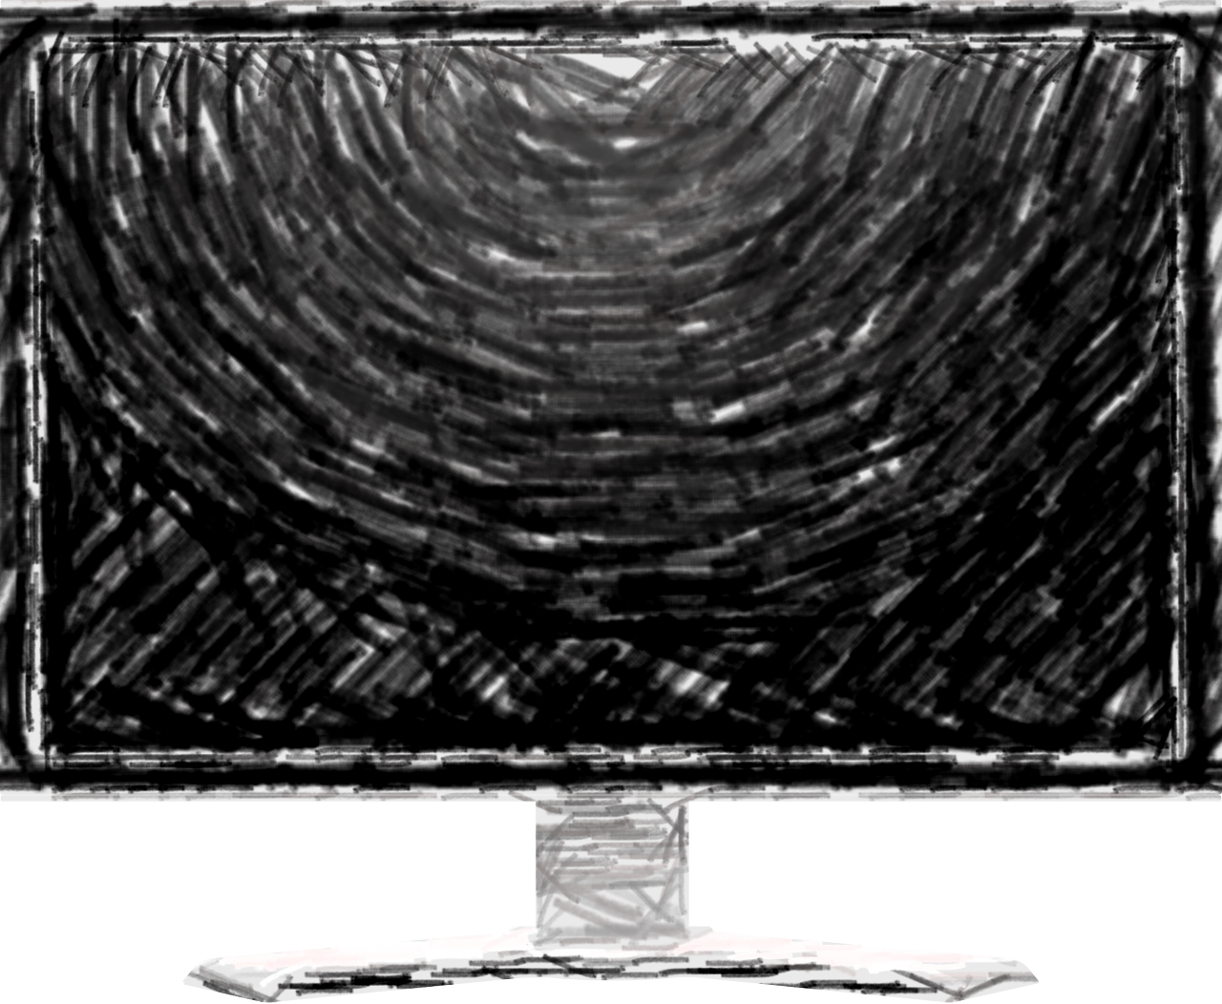
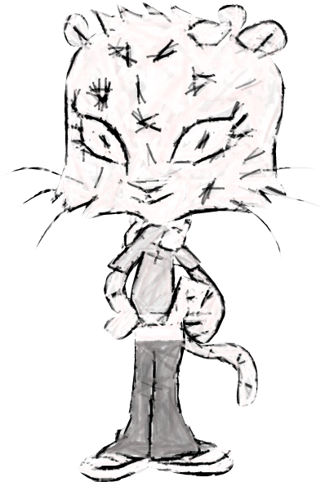

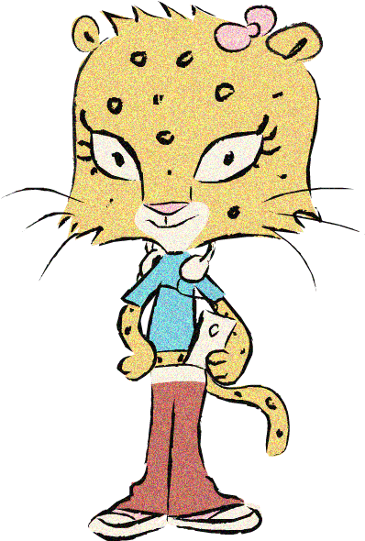

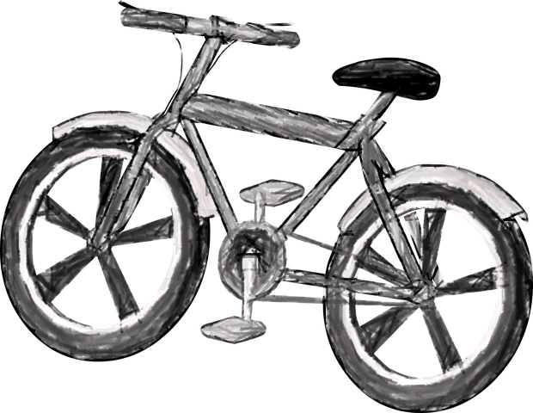
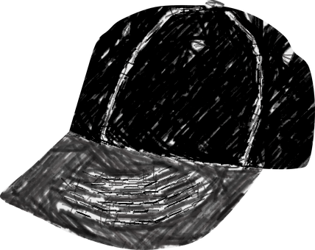
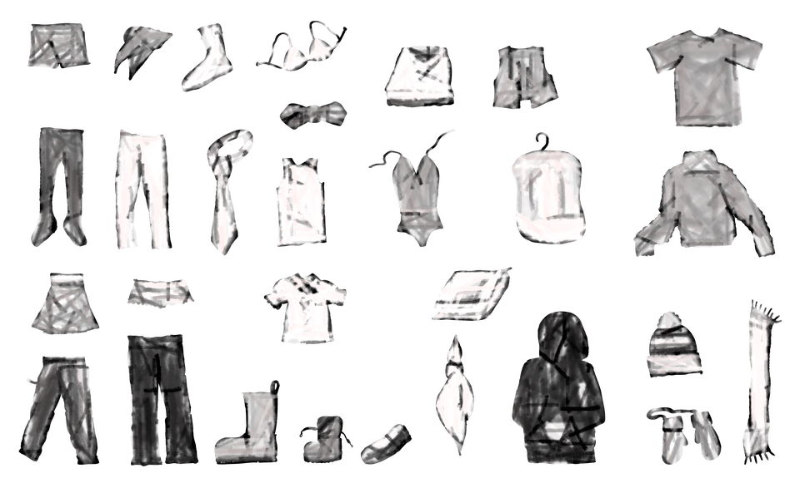
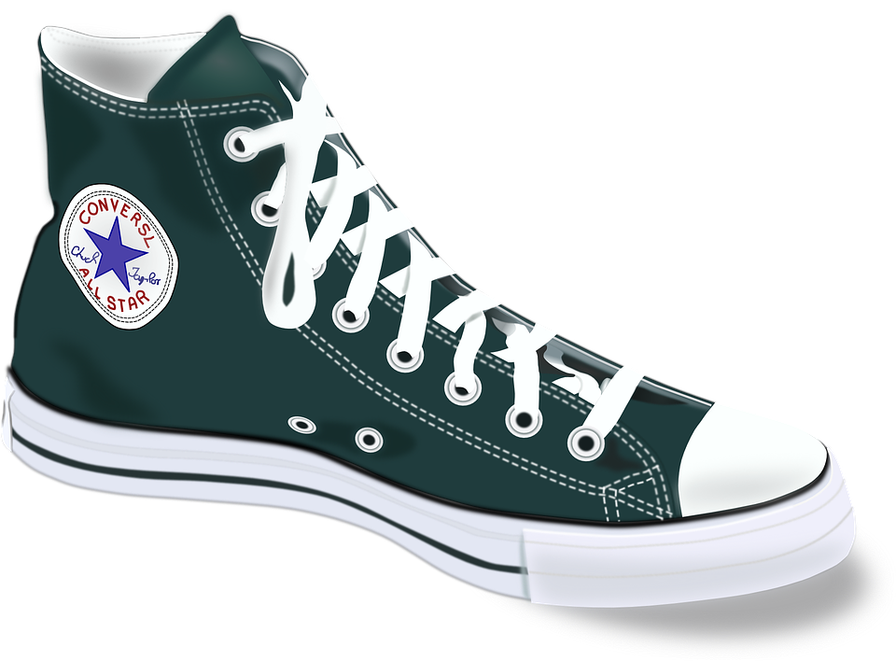
I drew my mum and my dad because they look after me and my cheeky twin brothers. They make sure we have everything we need.
I also drew my grandparents talking to me on a video message. They might live far away, but they always take the time to find out about how I am getting on.
My family are extra special because I love to spend time with them. I drew our bikes because cycling is one of our favourite things to do together.
6
© Young Citizens

Slide 7

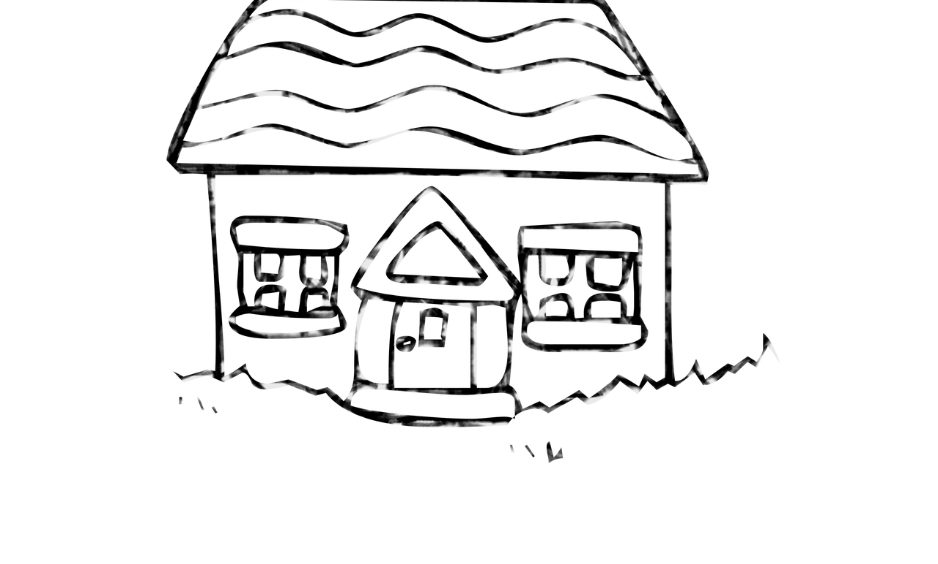
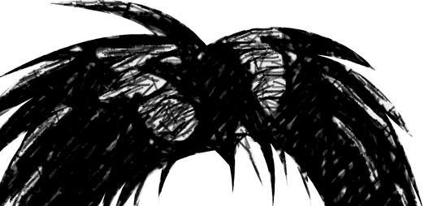
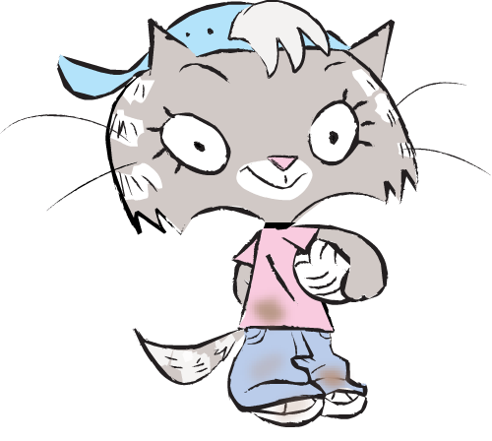
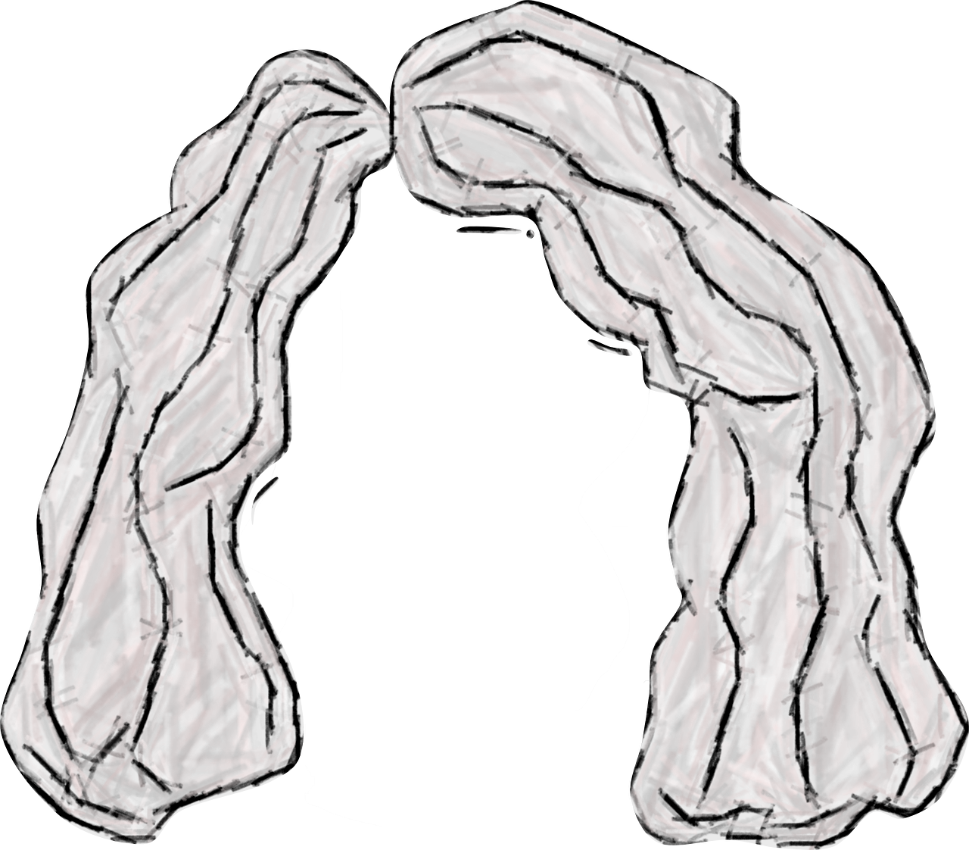
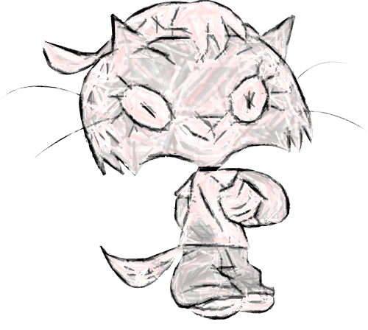
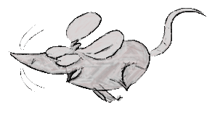
There are two houses because sometimes I live with my mum and sometimes I live with my dad.
I drew a big heart because there is a lot of love in my family. My mum gives the best hugs, my dad can always make me laugh and my pet mouse is great to play with.
I drew my mum, my dad, my pet mouse and me.
7
© Young Citizens

Slide 8
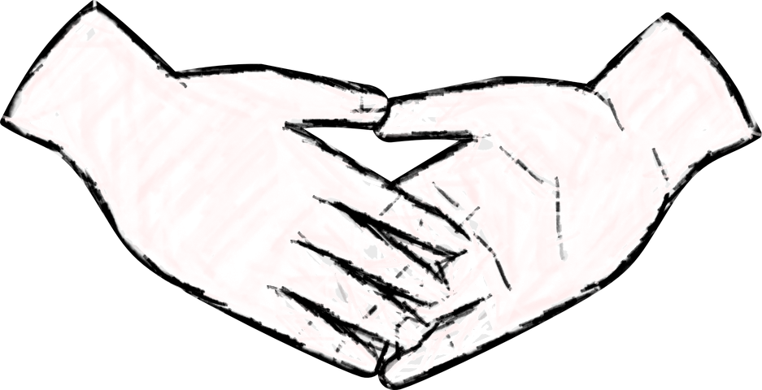
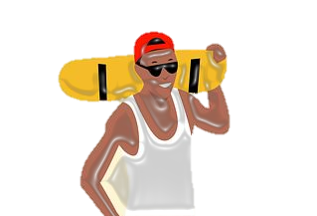
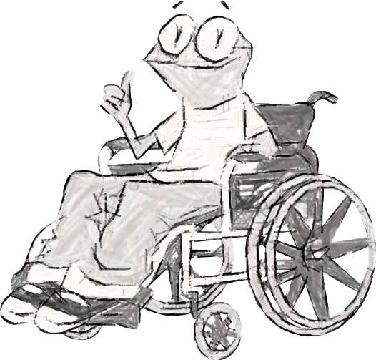
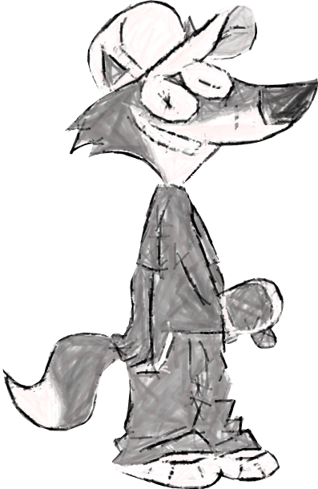
I drew a helping hand because Pete is always there for me if I need cheering up.
My dad is special because he always makes time for me. This is a picture of us enjoying our Friday movie night.
I also drew Dan my skating coach. My confidence has grown so much since I started lessons with him.
I drew my dad, my best friend Pete, my skating coach and me.
8
© Young Citizens

Slide 9
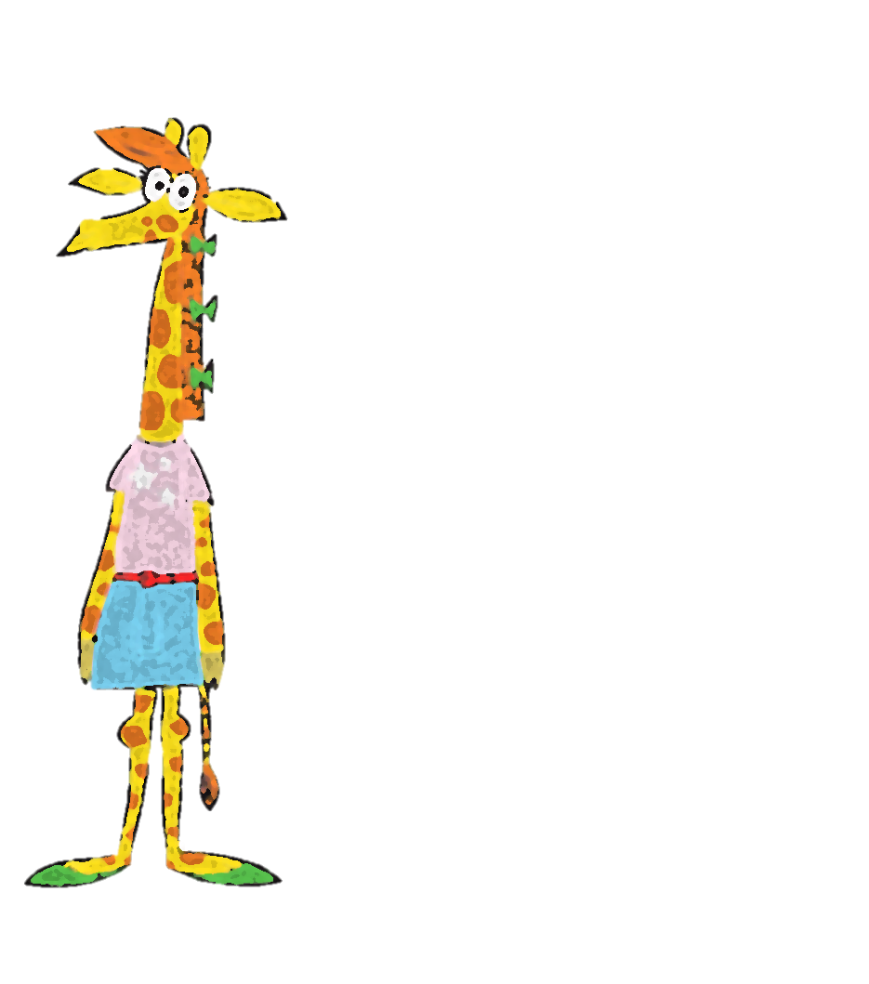
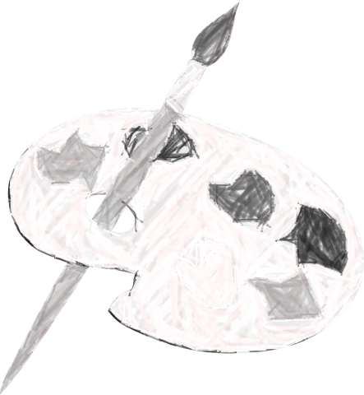
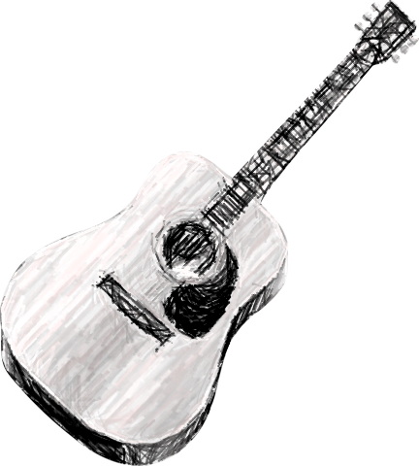
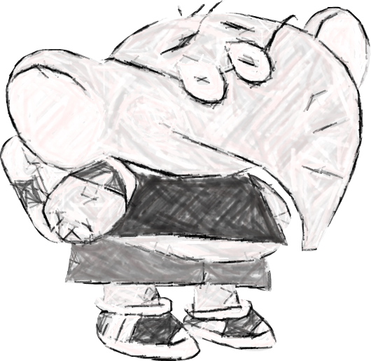
My parents encourage me to learn new things like playing the guitar and painting.
My little sister looks ups to me and I hope to teach her one day.
My special people are my mums, my baby sister and my friend Mitali.
I know I can always talk to my mums if I have a worry, that’s why I drew the speech bubble.
Mitali is special to all my family. He is kind, fun and thoughtful. He’s almost like a brother to me.
9
© Young Citizens

Slide 10
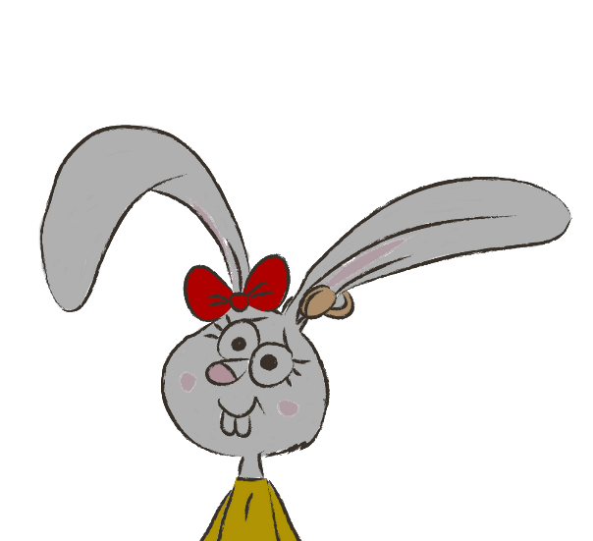
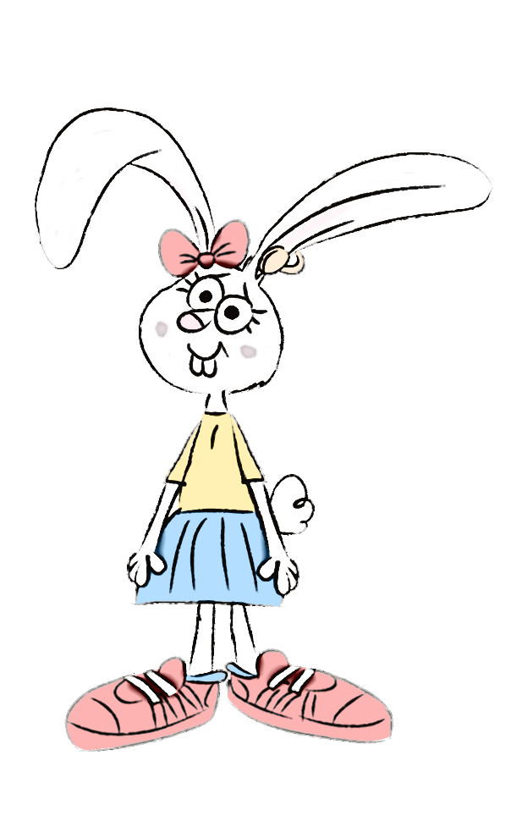


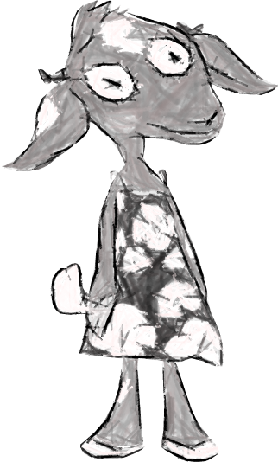

I’ve been staying with Sarah for four months and we enjoy cooking and reading together.
Foster parents, like Sarah, are adults that are specially chosen to look after children when their parents or other family members are not able to look after them.
Ahmeti is a special friend because she has an amazing imagination and comes up with fun games to play.
I also drew my family in a thought bubble to show that I think about them a lot, even though I don’t live with them right now.
I drew my foster mum called Sarah and my friend Ahmeti.
10
© Young Citizens

Slide 11
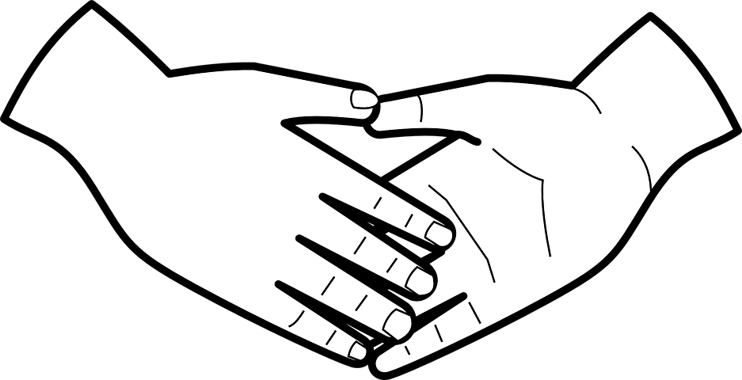

The Go-Givers gave reasons why people were special to them.
Care
Love
Special People
Enjoying doing things together
Learning from each other
11
© Young Citizens

Slide 12
Q. Who is special to you?
Q. What makes them ///special?
Care
Love
Special People
Enjoying doing things together
Learning from each other
12
© Young Citizens

Slide 13

Draw your ‘Special People’.
Try to show some of the reasons they are special to you in your picture.
13
© Young Citizens

Slide 14
Our pictures all look very different!
Q. Does that matter?
14
© Young Citizens

Slide 15
Our families, friendship groups and communities might look very different.
But the important thing is that the special people in our lives make us feel happy, loved and cared for.
15
© Young Citizens

Slide 16

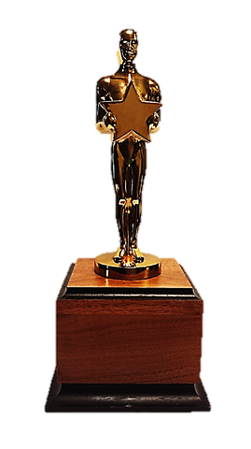


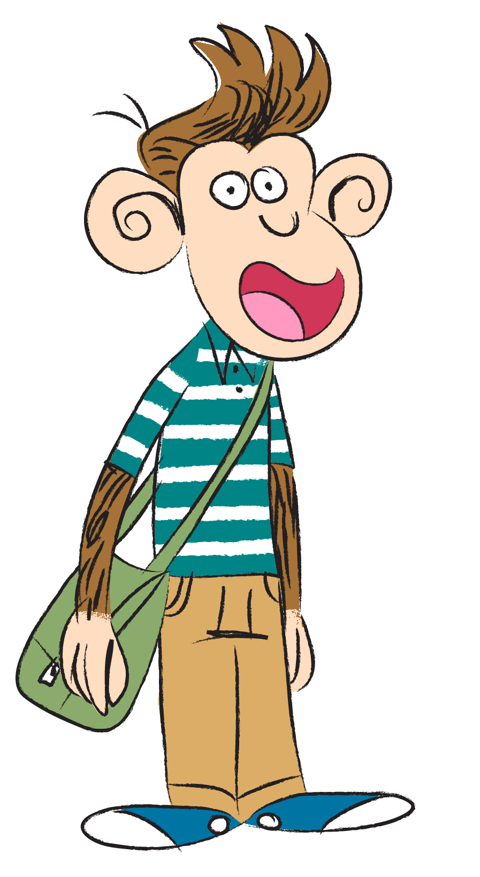
Award ceremonies are events at which prizes are given to people to celebrate their achievements.
16
© Young Citizens

Slide 17


Imagine there was an award ceremony for the special people in your life.
Who would win these awards and why?
The person who helps me the most.
The person who I can always go to with a problem.
The person who makes me smile the most.
17
© Young Citizens

Slide 18
What other awards could you give to the special people in your lives?
The person who…
The person who…
The person who…
18
© Young Citizens

Slide 19
It’s lovely to get an award but we can’t give awards everyday.
Q. How else can we show people ///that they are special to us?
19
© Young Citizens

