Slide 1


I am unique

Slide 2

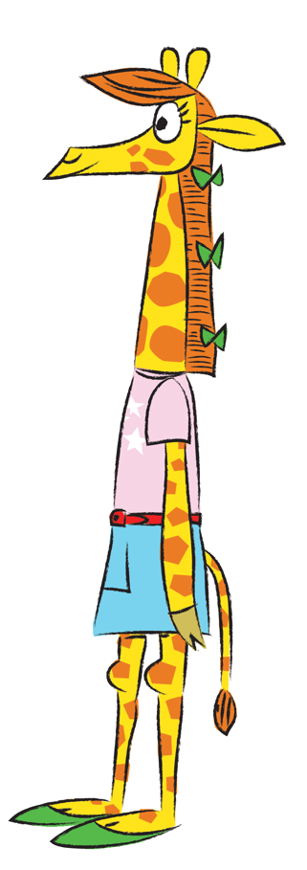
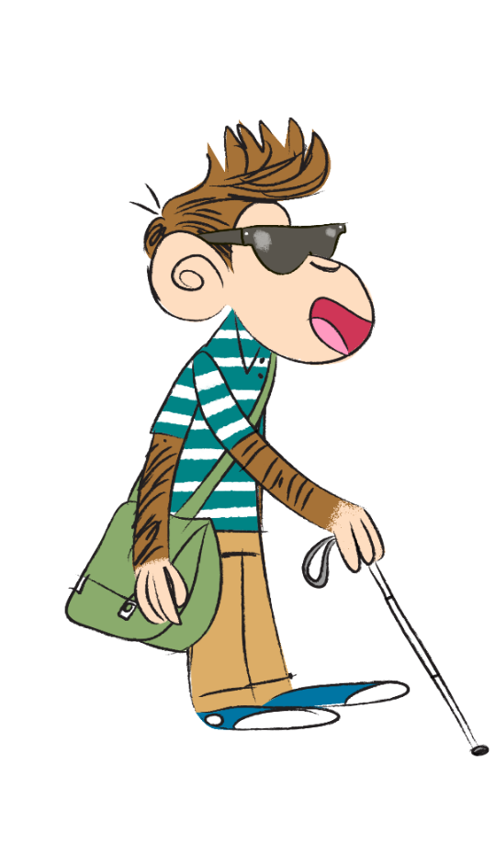
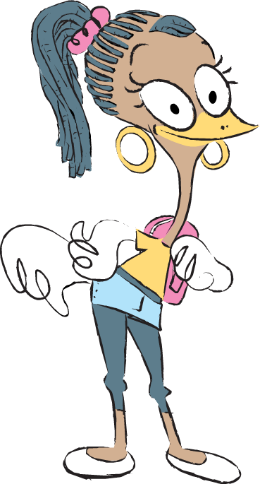
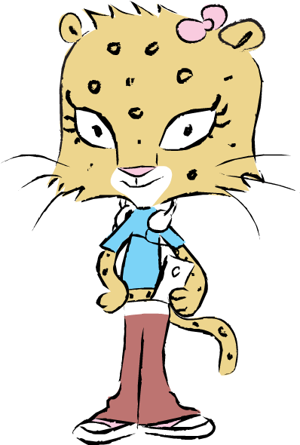
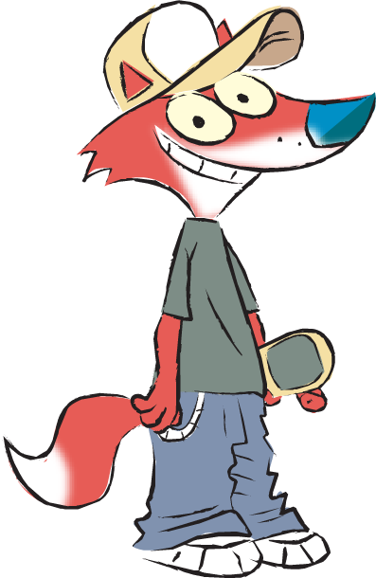
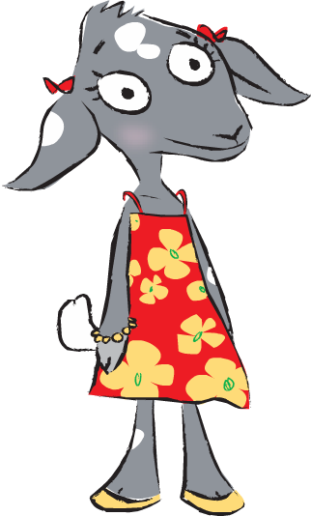
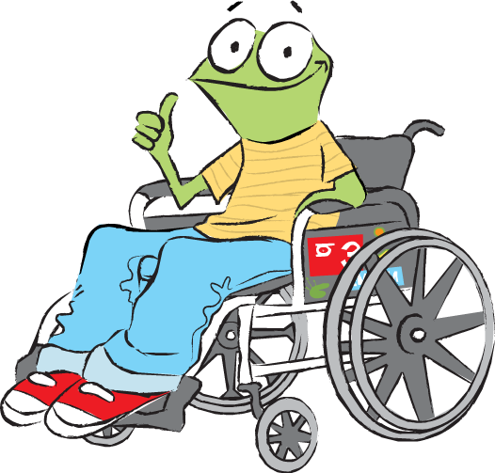
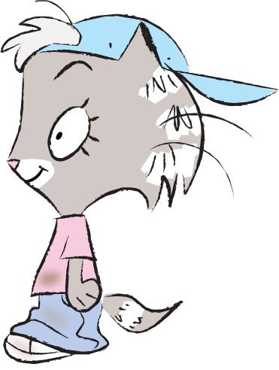
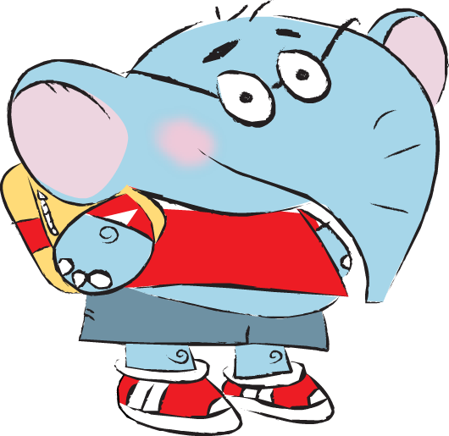
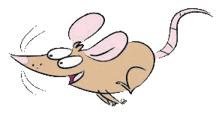
In this lesson we will be thinking about things that makes each person special and different.
2
© Young Citizens

Slide 3


Let’s start by playing one of my favourite games ‘Creature Creations’!
All you need is paper, pencils and some imagination.
3
© Young Citizens

Slide 4
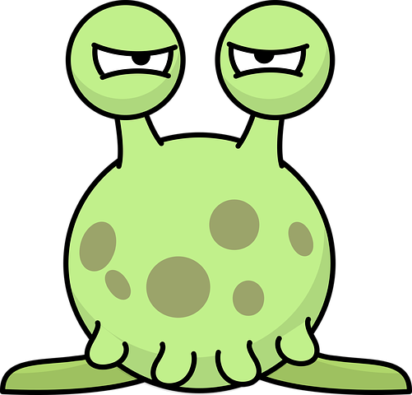
Without showing anyone, draw the head and neck of an imaginary creature at the top of the sheet of paper.
4
© Young Citizens

Slide 5
Fold over the paper, so only a little bit of the creature’s neck can still be seen.
Pass the paper on to a new person.
5
© Young Citizens

Slide 6
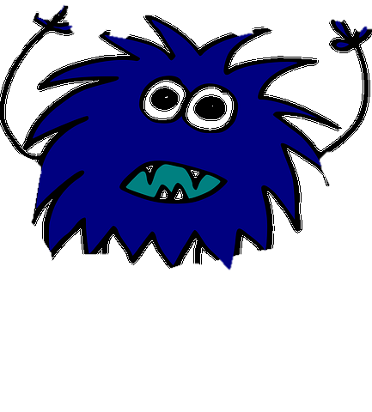
Don’t peep, now draw the body and arms of an imaginary creature.
6
© Young Citizens

Slide 7
Fold over the paper again so only a little bit of the creature’s body is showing.
Pass the paper on to a new person.
7
© Young Citizens

Slide 8
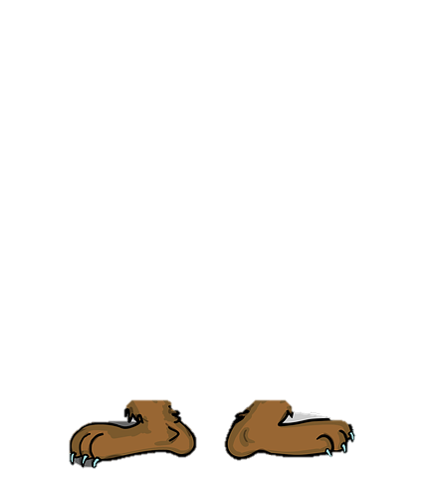
Make sure you’re still not peeping, now draw the legs and feet of an imaginary creature.
8
© Young Citizens

Slide 9
Fold over the paper one last time.
Pass the paper on to a new person.
9
© Young Citizens

Slide 10
Finally, unfold the paper to discover the creature that has been created.
10
© Young Citizens

Slide 11

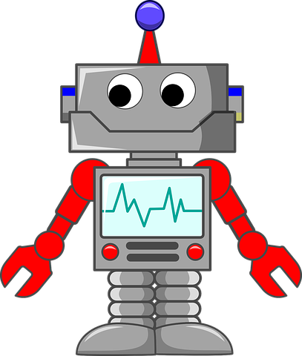
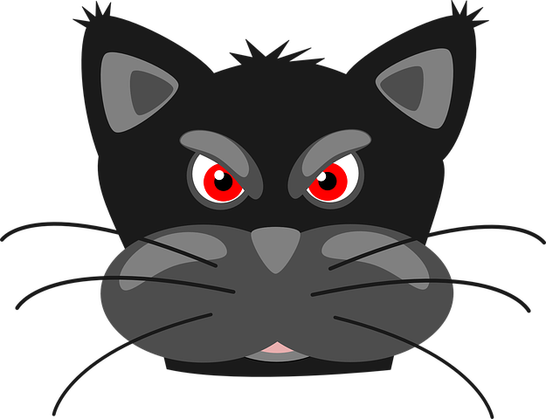
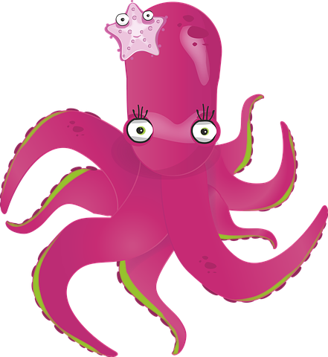
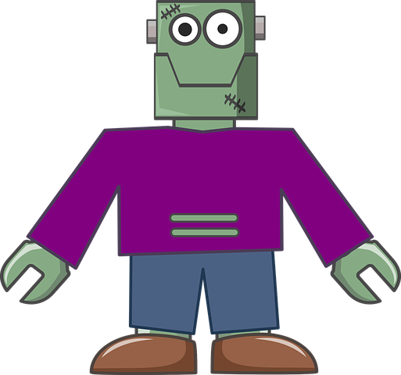
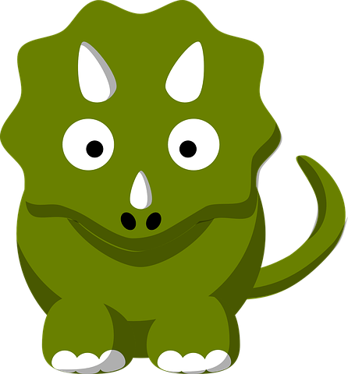
Q. Why were all the ///creatures we ///created different?
11
© Young Citizens

Slide 12
The creatures were all different because everyone in the class has their own drawing style and their own imagination.
The differences between us are what make the pictures unique.
12
© Young Citizens

Slide 13
Unique-
The only one of its kind.
13
© Young Citizens

Slide 14
Like the pictures we made, everyone of us is unique.
There is nobody alive today, nobody who has lived and nobody who will live that will ever be the same as you.
There is no one quite like you or me!
It would be impossible to replace any of us!
Wow! That’s amazing!
So, what makes us all unique?
14
© Young Citizens

Slide 15
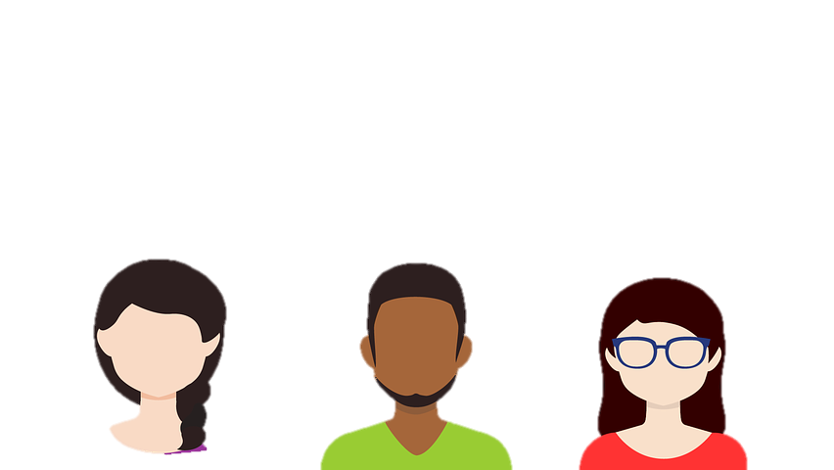
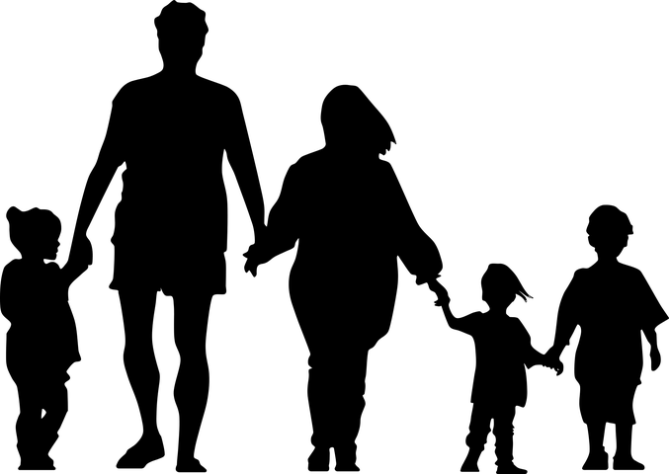
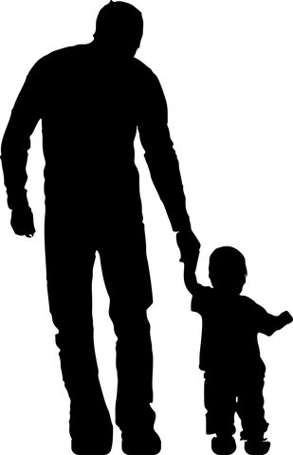











Family
Appearance
Thoughts, feelings and memories.
We are all unique because of our special mixture of different…
Age and experiences
Likes and dislikes
Hopes and wishes
Beliefs
Skills and talents
15
© Young Citizens

Slide 16
Let’s start with a game that gets us thinking about what makes our classmates unique.
16
© Young Citizens

Slide 17

Who am I?
Write your name on a slip of paper and answer some questions chosen by your teacher.
Do not let anyone see your answers.
Name:
Q1. What colour are your ////eyes?
Q2. What do you most like ///about school?
Q3. What makes you laugh?
17
© Young Citizens

Slide 18
Who am I?
Q. How were people similar to you?
Q. How were people different to you?
Q. Would you like to be in a class in ///which everyone was the same?
18
© Young Citizens

Slide 19
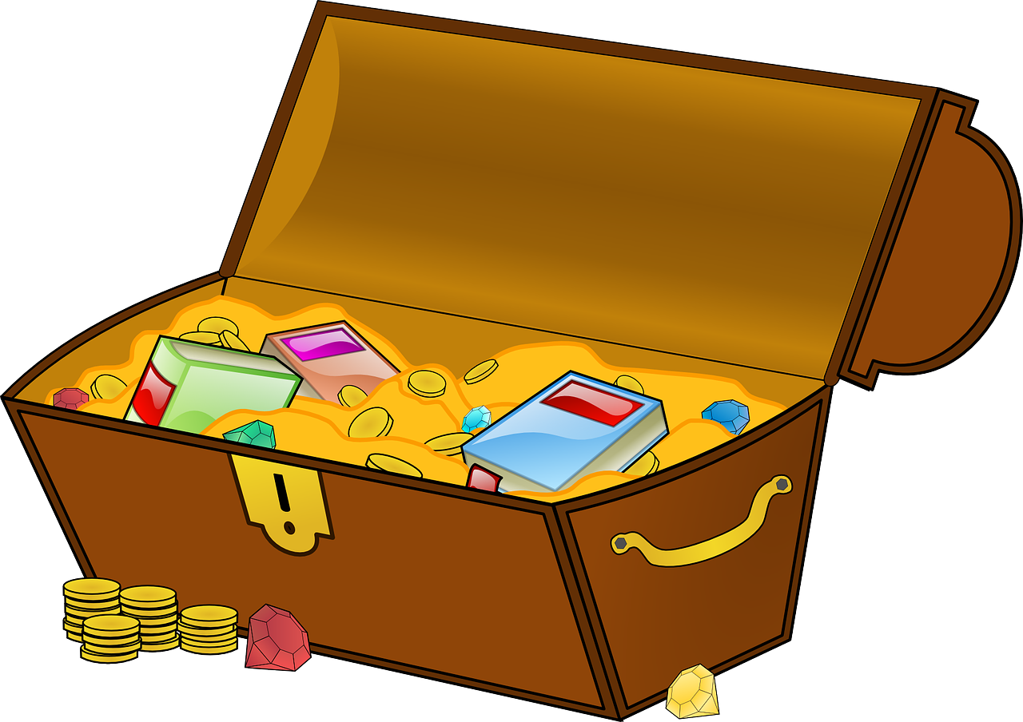
Class treasure hunt
1. On your sheet you have a list of ///treasures (talents or skills).
2. When you find a person with that ///talent get them to write their ///name on your sheet.
3. You can only collect a person’s ///name for one treasure.
4. The person who finds the most //class treasures is the winner.
Someone who can bake a cake.
Someone who plays an instrument.
A person who can do a cartwheel.
19
© Young Citizens

Slide 20
Class treasure hunt
Q. Why are our talents and skills ///like treasures?
Q. What other skills and talents do ///we have?
Q. Why is it good that we have ///people with different talents ///and skills in our class and in our ///world?
Someone who can bake a cake.
Someone who plays an instrument.
A person who can do a cartwheel.
20
© Young Citizens

Slide 21
Poetry Plenary
There’s nobody quite like me!
I smile when ,
I have a talent for ,
Sometimes I imagine ,
I wish ,
I’m the only one ,
There’s nobody quite like me and there never will be.
Complete the lines to write a poem about some of the things that make you unique.
21
© Young Citizens

Slide 22
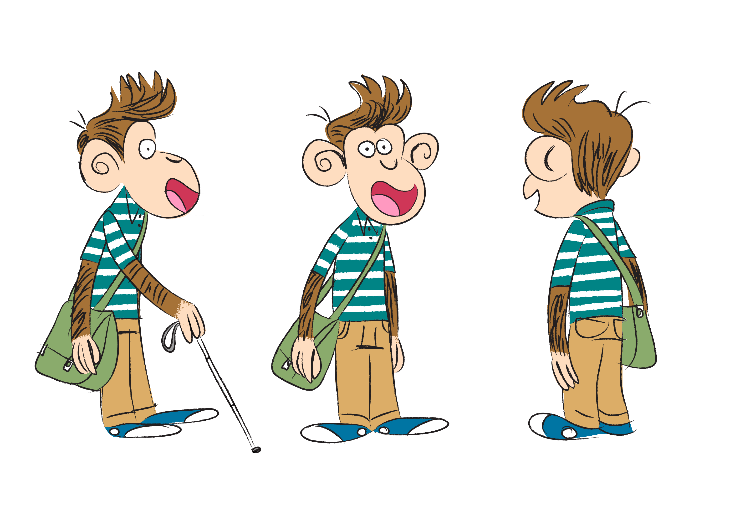
There’s nobody quite like me!
I smile when I score the winning goal,
I have a talent for climbing trees,
Sometimes I imagine I’m an explorer,
I wish I could travel into Space,
I’m the only one with these paw prints.
There’s nobody quite like me and there never will be.
There’s nobody quite like me!
I smile when I hear a silly joke,
I have a talent for telling stories,
Sometimes I imagine I’m a superhero,
I wish I could fly,
I’m the only one who Matt calls his brother.
There’s nobody quite like me and there never will be.
22
© Young Citizens

Slide 23
Unique artwork extensions
23
© Young Citizens

Slide 24


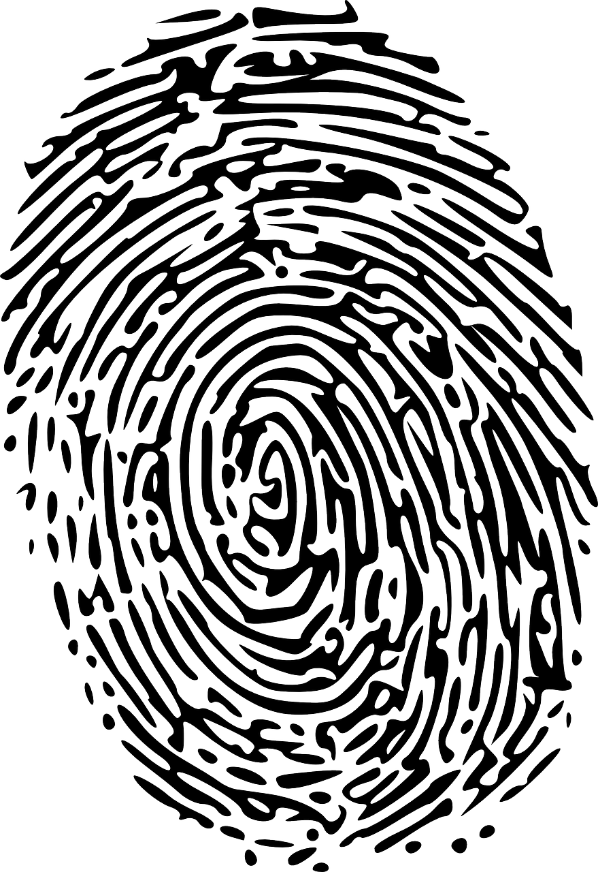

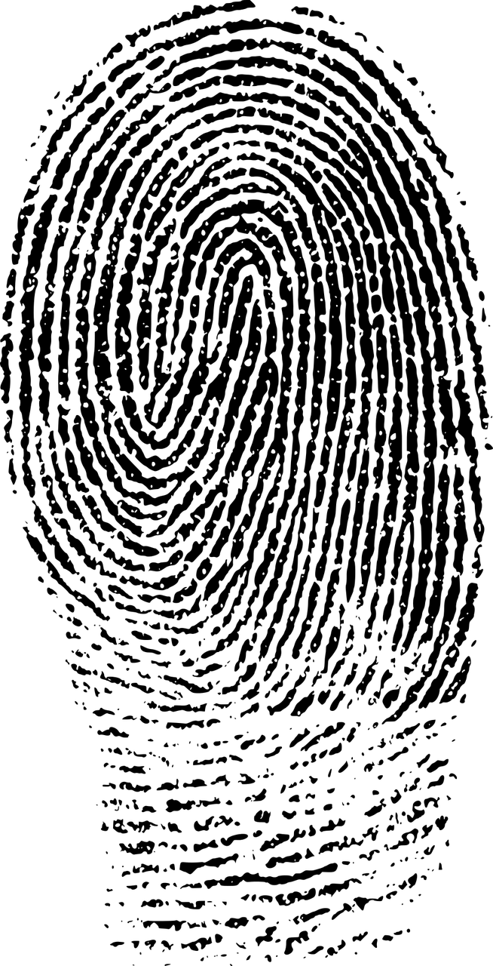
The biscuit mystery
Can you find out which teacher took the last biscuits?
Mr Oni
Miss Scarlett
Mrs Costa
Mr Bull
24
© Young Citizens

Slide 25
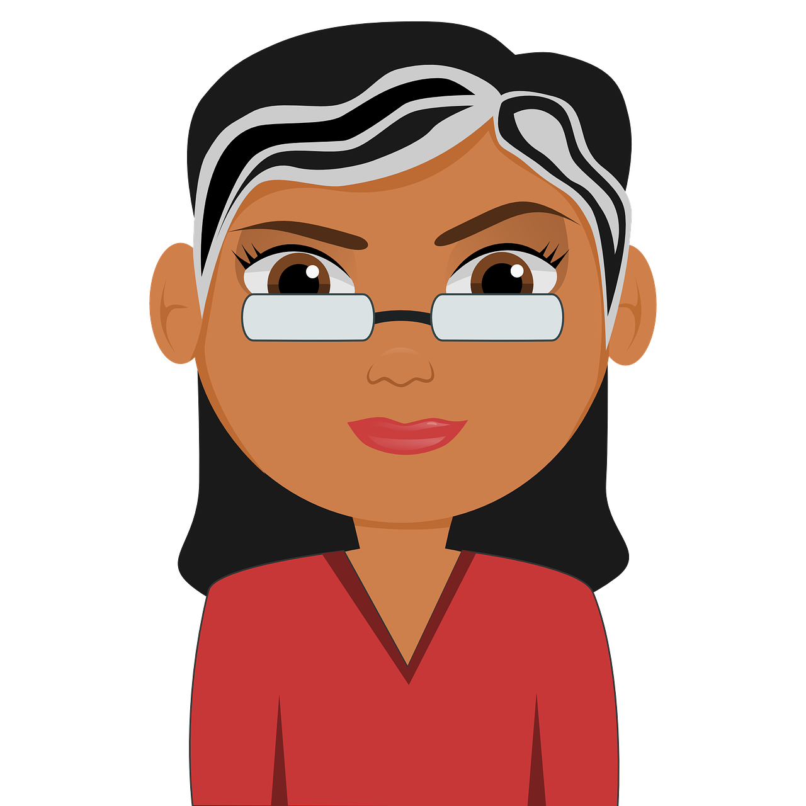
Yes it was me, Miss Scarlett.
I promise to buy more biscuits for the other teachers.
How did you know it was me?
25
© Young Citizens

Slide 26

No two fingerprints, even those of identical twins, have ever been found to be exactly the same.
Why not take a look at the unique prints in your class.
26
© Young Citizens
Notes:
References:
https://science.howstuffworks.com/fingerprinting1.htm

Slide 27
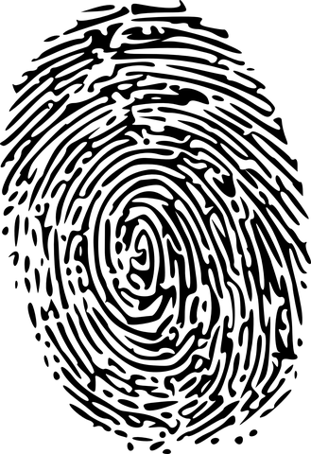
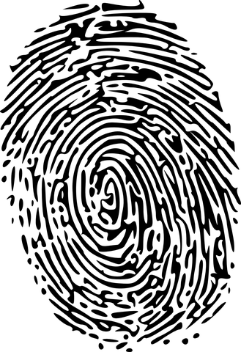
Using your fingerprints and pencils have a go at creating an artwork like no other.
Fingerprint Art
27
© Young Citizens

Slide 28


Snowflakes
Start with a piece of paper cut into a circle.
Fold the circle in half.
Fold in half again.
Carefully cut small lines and shapes out of the folded paper.
////Be careful not to cut too ////far or too much.
5. Unfold the paper to see ////your snowflake.
Did you know that just like us, every snowflake is beautifully unique?
28
© Young Citizens
Notes:
References:
https://science.howstuffworks.com/nature/climate-weather/atmospheric/is-every-snowflake-actually-unique.htm

